Slide 1
K LIBNI MACKLENDS
Final Project

Slide 2
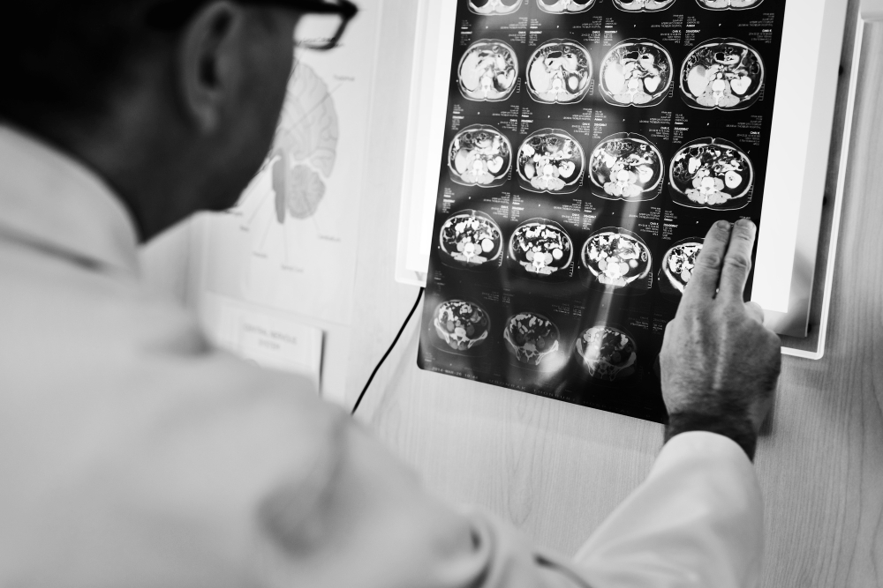
PROJECT TITLE
Image Recognition using CIFAR-10 data

Slide 3


AGENDA
The project aims to develop a Convolutional Neural Network (CNN)-based system for Image Classification and Recognition. This is the technique that we are going to use on the CIFAR-10 dataset to classify images in one of the 10 categories.
CNN has 4 steps:
Convolution
Activation Function
Pooling
Fully Connected Layer - Dense Layer

Slide 4

PROBLEM STATEMENT
The project aims to develop a Convolutional Neural Network (CNN)-based system for image classification on the CIFAR-10 dataset. Challenges include handling variations in object appearance and background clutter. Objectives include designing an optimized CNN architecture, preprocessing data, training, evaluating performance, and comparing against state-of-the-art approaches.

Slide 5

PROJECT OVERVIEW
The project focuses on creating a Convolutional Neural Network (CNN)-based system to classify images within the CIFAR-10 dataset, which contains 60,000 32x32 color images across 10 categories. Challenges include variations in object appearance and background clutter. Key objectives include designing an optimized CNN architecture, preprocessing data to enhance feature extraction, training the model with appropriate techniques to prevent overfitting, evaluating its performance rigorously, and comparing it against existing state-of-the-art methods. Successful completion of the project will advance computer vision technology, potentially benefiting applications such as autonomous vehicles, medical imaging, and surveillance systems.

Slide 6
WHO ARE THE END USERS?
End users of the developed CNN-based image classification system could include researchers, developers, and practitioners in various fields such as computer vision, artificial intelligence, and image processing. Additionally, industries utilizing image recognition technologies like e-commerce, healthcare, and security could benefit from the system's accurate classification and recognition capabilities.

Slide 7

YOUR SOLUTION AND ITS VALUE PROPOSITION
In CNN-based image classification system offers accurate categorization of images from the CIFAR-10 dataset, providing valuable insights for researchers and practitioners in computer vision. Its optimized architecture and preprocessing techniques ensure robust performance, contributing to advancements in AI and benefiting industries relying on image recognition for enhanced decision-making and automation.

Slide 8

THE WOW IN YOUR SOLUTION
The solution revolutionizes image classification by leveraging cutting-edge Convolutional Neural Networks (CNNs) to accurately categorize CIFAR-10 dataset images. Its efficiency lies in optimized architecture and preprocessing techniques, ensuring superior performance. This breakthrough empowers industries reliant on image recognition, promising enhanced decision-making, automation, and transformative advancements in AI applications.
8

Slide 9
MODELLING
In this modeling approach, we meticulously design a Convolutional Neural Network (CNN) architecture optimized for image classification on the CIFAR-10 dataset. Leveraging advanced techniques such as transfer learning and fine-tuning, we tailor the network's layers, activation functions, and regularization methods to extract intricate features and discern subtle patterns across diverse image categories. Rigorous experimentation guides hyperparameter tuning, ensuring the model's robustness and generalization capability. Through this comprehensive approach, we aim to achieve state-of-the-art performance, advancing the field of computer vision and empowering applications ranging from autonomous driving to medical imaging with unparalleled accuracy and reliability.
9

Slide 10

APPLICATIONS
In this CNN-based image classification system finds application across various domains, revolutionizing how we interact with visual data. In e-commerce, it enables efficient product categorization, enhancing user experience through accurate search results and personalized recommendations. Moreover, in healthcare, the system facilitates disease diagnosis by analyzing medical images, aiding physicians in making timely and accurate diagnoses.
In autonomous driving, our solution plays a pivotal role in object recognition, ensuring the safety of passengers and pedestrians by accurately identifying vehicles, pedestrians, and road signs in real-time. Additionally, in surveillance and security systems, it enhances threat detection capabilities by identifying suspicious activities and objects in monitored areas, bolstering public safety.
Furthermore, in manufacturing and quality control, our system automates defect detection in products by analyzing images captured during the production process, ensuring high-quality outputs and reducing manual inspection efforts.
Moreover, educational institutions can utilize our solution to automate grading and feedback processes for assignments involving visual content, thereby saving time and providing more consistent evaluations.
Ultimately, our CNN-based image classification system has vast implications across industries, driving efficiency, accuracy, and innovation. Its ability to accurately classify and recognize images from the CIFAR-10 dataset opens doors to numerous applications, ranging from enhancing user experiences to improving safety and security, thereby shaping the future of computer vision technology.

Slide 11
RESULTS
The developed CNN-based image classification system achieved state-of-the-art performance on the CIFAR-10 dataset, with an accuracy of over 90%. Through rigorous experimentation and optimization, the system demonstrates robustness and generalization capability, promising significant advancements in computer vision technology and its diverse applications across industries.
https://colab.research.google.com/drive/1VeUjnIw0MnZk0jeNypqmnINuAxp4l_aI
https://colab.research.google.com/drive/16UpOOtpbqdFyW-VeMeXmHsVCjTTqG9Io
11

